Slide 1
Particle Tracing Earth
Trial Simulations
Updated 27/06
Nonlinear interaction of energetic electrons with large amplitude chorus
J. Bortnik, 1 R. M. Thorne, 1 and U. S. Inan 2

Slide 2
Particle distribution type
Test particles
Linearly spaced : (0 – 2π)

Slide 3
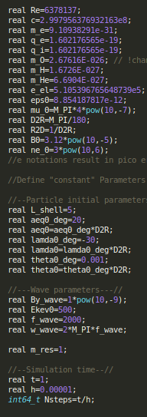
Achieve non linearity
Simulation Parameters:
-L_shell= 5
-theta0_deg = 0.001
-aeq0_deg=20
-lamda0_deg=-30
-Ekev0=500(LARGE)
-By_wave = 1nT (LARGE)
-ne0 = 3cm ^-3(low density plasma)
=> resonance (dh/dt = 0) @ lamda = 23 deg (HIGH)

Slide 4
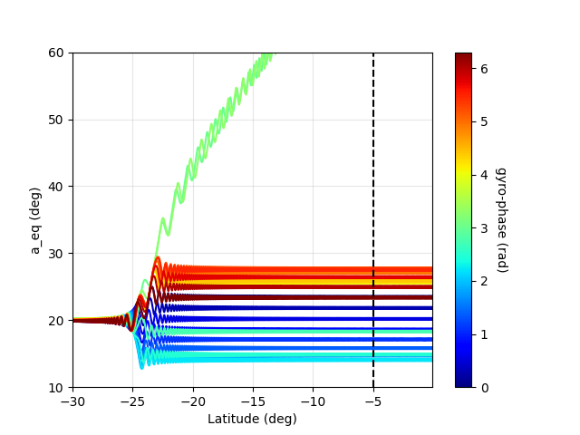
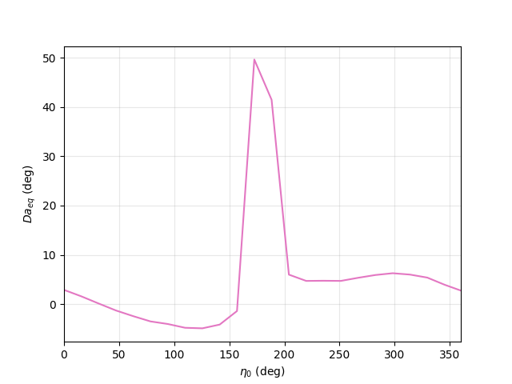
Achieve non linearity, 24 particles
Execution time: ~0.6s
System Hyperlink
Phase traping.
Eta0_deg @ 0-361
Max is @ 177.44 deg

Slide 5
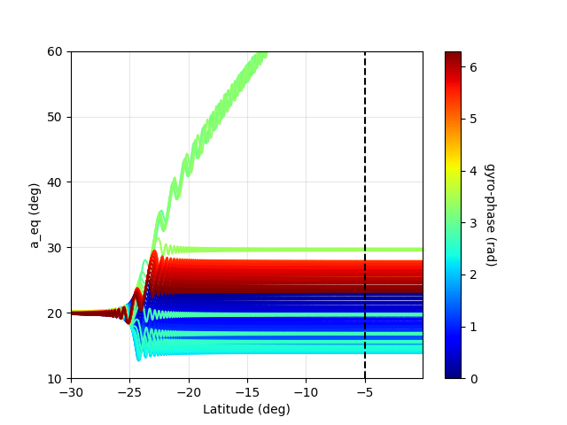
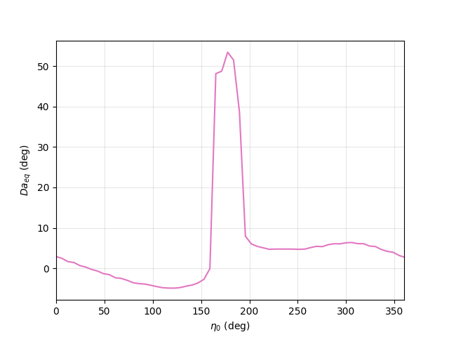
Achieve non linearity, 60 particles
Execution time: ~1.5 s
Phase traping
Eta0_deg @ 0-361
Max is @ 172.65 deg

Slide 6
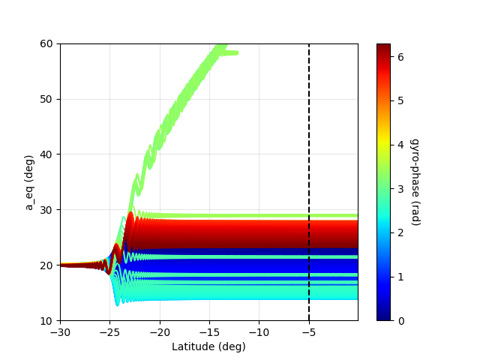
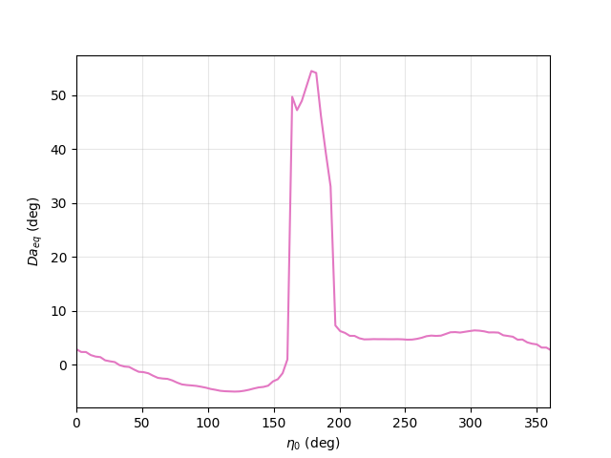
Achieve non linearity, 100 particles
Execution time: ~2.2 s
Phase traping
Eta0_deg @ 0-361
Max is @ 178.677 deg

Slide 7

Simulate around effective etas
Since we had max values @177.44 deg,172.65 deg,178.677 deg
Weighted average would be
=
176.16 deg
Test particles
Linearly spaced
Start: 176.16 – 360/population
Stop: 176.16 + 360/population

Slide 8
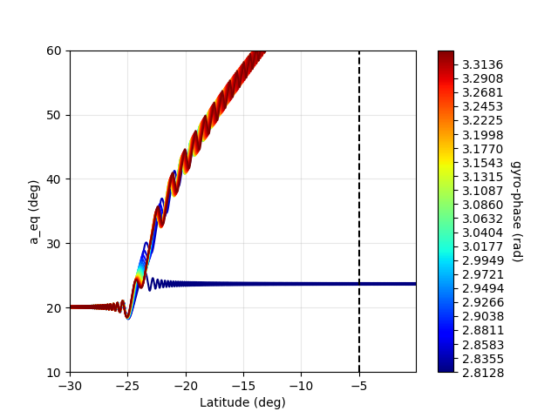
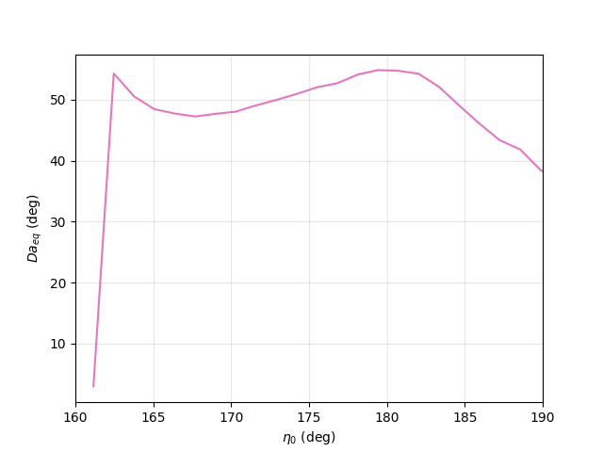
Arround 176.16 deg, 24 particles
Execution time: ~2.5 s
Eta0_deg @~ 161-191
Max is @ 179.42 deg
Almost all are trapped

Slide 9
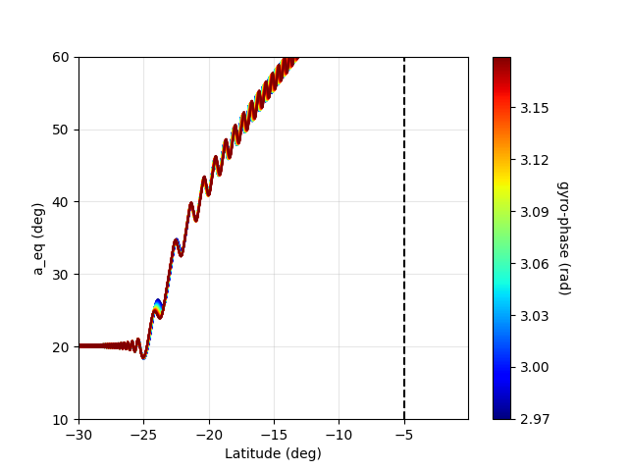
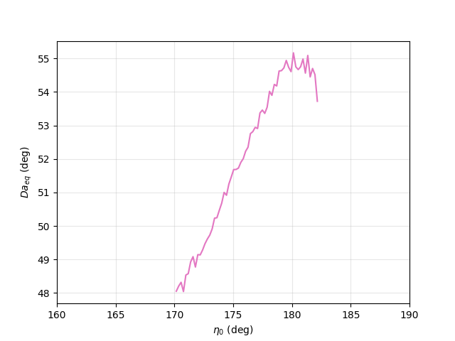
Arround 176.16 deg, 60 particles
Execution time: ~8 s
Eta0_deg @~ 170-182
Max is @ 180.126 deg
All trapped
Ascending Δa

Slide 10
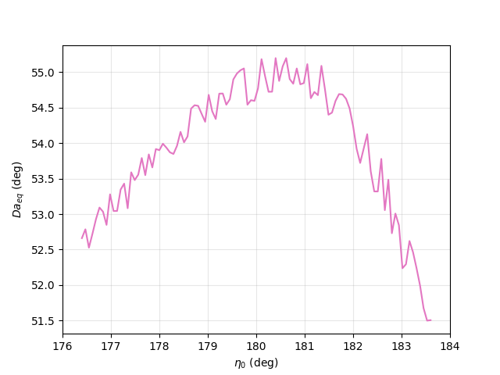
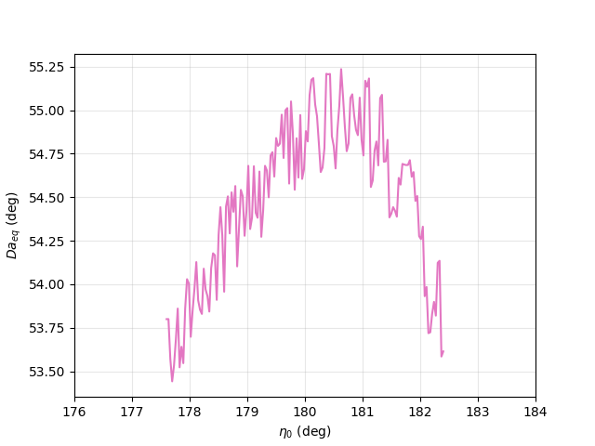
Arround 180 deg, 100 & 150 particles
100 Particles Eta0_deg@~176-184
Ex. time: ~10s Max is @ 180.4 deg
150 Particles Eta0_deg@~178-182
Ex.time: ~15s Max is @ 180.63

